Slide 1
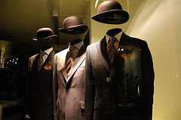
The unstoppable power of
leaderless organisations
A tale about the sweet spot between centralisation and decentralisation

Slide 2
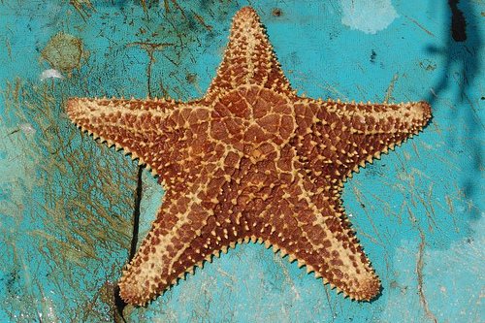
Starfish
The harder you fight him, the stronger it gets

Slide 3
Look at the slide and decide which of the 2 pictures has “a head” (someone in charge) and which one is left without a leader.

Slide 4
Challenge 1

Slide 5
The internet does not have a president; a library does

Slide 6
What about challenge 2 ?

Slide 7
The music industry has presidents; Emule (P2P-sharing) does not (we don’t even know who founded it, so there is no one to sue ☺)

Slide 8
Challenge 3: spot the starfish and the spider

Slide 9
The Apache were organised in independent circles; Farao’s were the kings of society

Slide 10
Challenge 4: starfish in sight?

Slide 11
The CIA is a centralized company; Al Qaida is an open system. It does not have central intelligence; the intelligence is spread throughout the system (it is made up of largely independent cells)

Slide 12
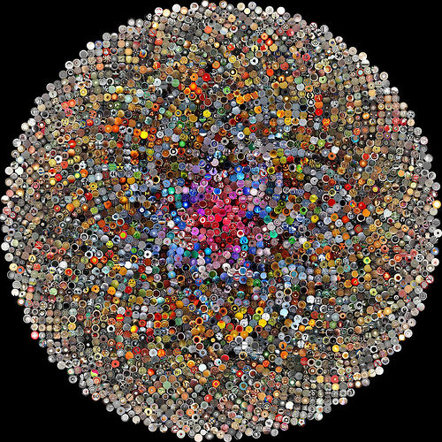
If you take out a cell no damage is done

Slide 13
Final challenge

Slide 14
You kinda get the picture, right?

Slide 15
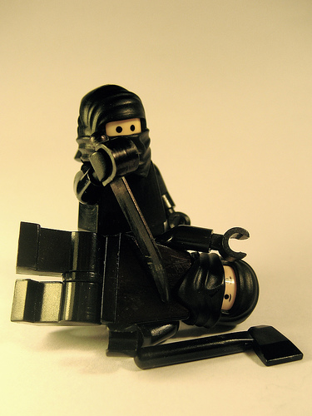
It’s a natural reaction, when attacked, to adopt a command-and-control mentality. But this strategy fails if you are fighting a starfish organisation.

Slide 16
What characterizes a starfish organisation?
Circles (many small non-hierarchical groups)
Catalyst(s)
Ideology
Preexisting network

Slide 17
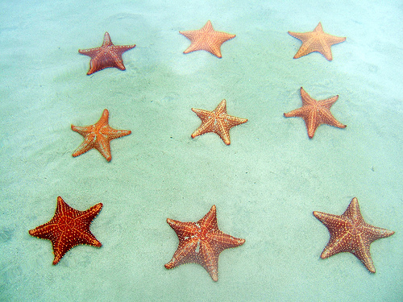
1. Starfish organisation consist of many small non-hierarchical groups (circles)

Slide 18
“In the internet era it’s much easier to form and join circles. But because participants aren’t spending every moment together, their bond isn’t as strong”.

Slide 19
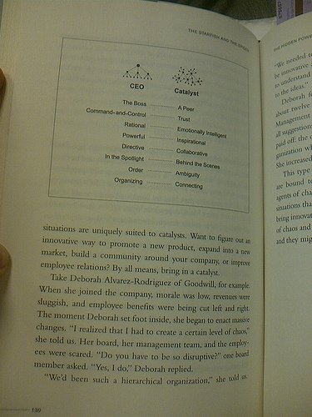
2. Starfish organisation are not run by CEO’s; in stead they can count on catalysts

Slide 20
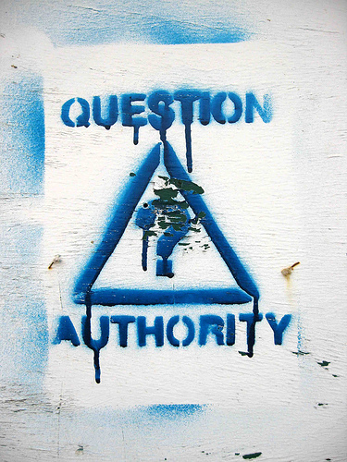
A catalyst knows that “values” (trust and understanding) are a stronger binding force than authority

Slide 21
“A catalyst is any element or compound that initiates a reaction without fusing into that reaction”
“A catalyst gets a decentralized organisation going and then cedes control to the members. In letting go of the leadership role, the catalyst transfers ownership and responsibility to the circle”

Slide 22
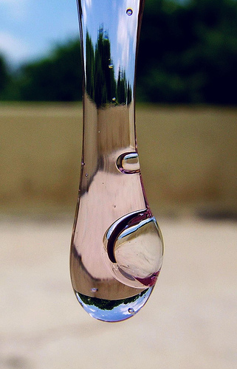
3. Ideology is the glue that holds decentralized organizations together

Slide 23
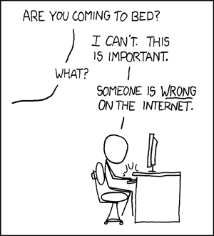
Put people in an open system and they automatically want to contribute

Slide 24
“However, starfish organisations spawned by the internet may have less meaningful ideologies than offline equivalents.
An Apache would do anything to save a fellow tribe member. Members of say Wikipedia aren’t going to die for each other”

Slide 25
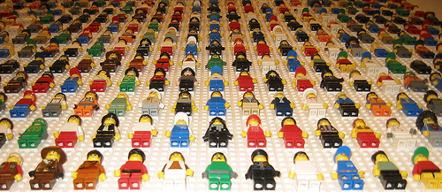
4. Almost every decentralized organization that has made it big, was launched from a preexisting platform

Slide 26
“Be aware that centralized organisations aren’t set up to launch decentralized movements. Leaders in top-down organisations want to control what’s happening, thereby limiting creativity”

Slide 27
Does this all mean that starfish organisations are invincible?

Slide 29
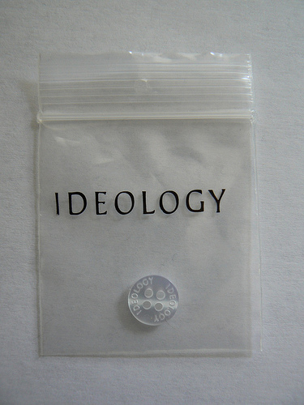
Strategy 1: Go after the and give them reasons to change it

Slide 30
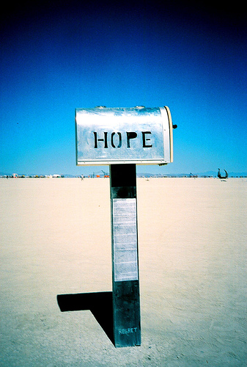
Give people tools Give people

Slide 31
Changing ideology succeeds best if your mission is not to change ideology but to help people

Slide 32
Strategy 2: centralize them!

Slide 33
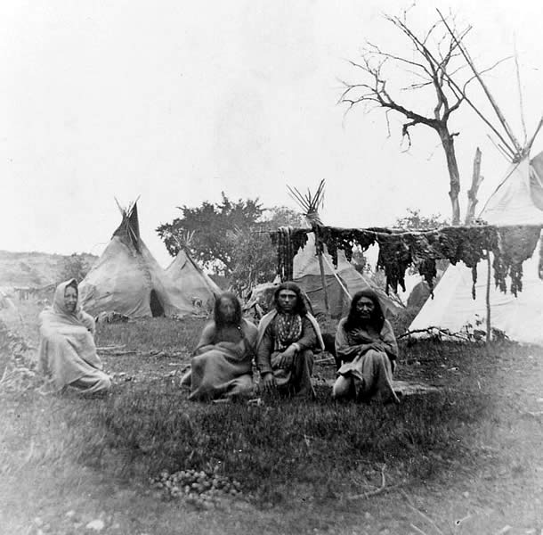
“When the Americans gave the Nant’ans (the catalysts in Apache society) cows, their power shifted from symbolic to material. The power structure, once flat, became hierarchical”

Slide 34
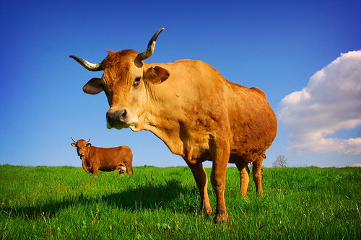
x
+ =

Slide 35
“Once people gain a right to property they quickly seek out a centralized system to protect their interests”

Slide 36
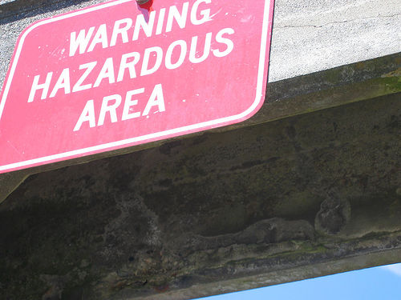
Looking from the starfish perspective:
If you want your starfish organisation to thrive,
be aware that you are not turning
a catalyst into a CEO!

Slide 37
Strategy 3 to combat starfish: decentralize yourself
If you can’t beat them, them

Slide 38
Does this all mean that starfish organisations are allways the best way to go?

Slide 40
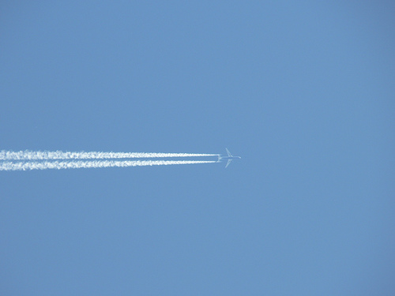
An airplane better had a captain on board

Slide 41
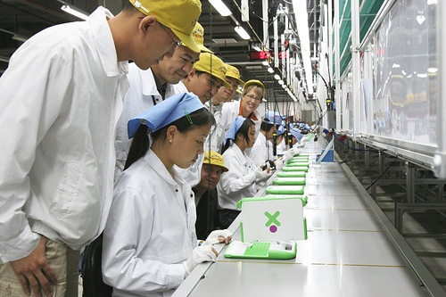
When you give people freedom you get incredible creativity but also variance. Variance is not always the way to go

Slide 42
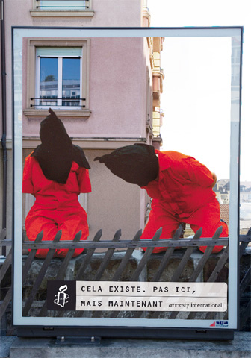
If you want to make a powerful statement for setting people free, you had better get organised

Slide 43
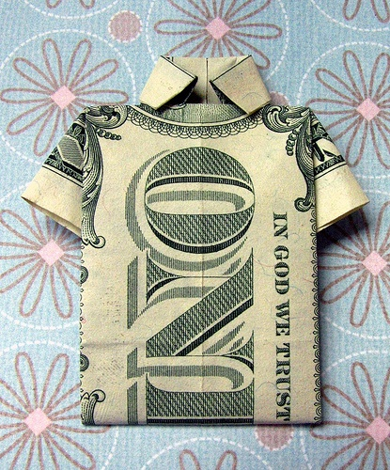
As industries become decentralized, overall profits decrease. So, if you are in for the money, you have to put in an element of centralisation.

Slide 44
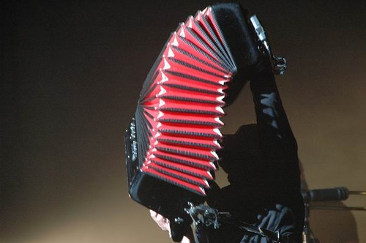
It’s all about finding the sweet spot between centralisation and decentralisation..

Slide 45
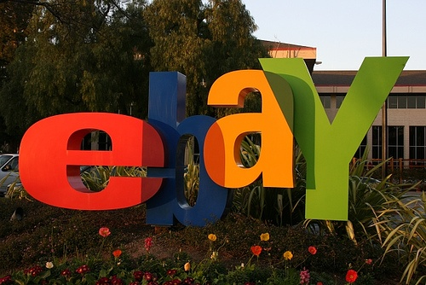
Take a centralized company with a decentralized user experience

Slide 46
“The more important security and accountability become in a given industry, the more likely that the sweet spot will tend toward centralization”

Slide 47
“Apple understood that the record labels were too centralized, but that illegal offerings like eMule posed too much a risk for many consumers”

Slide 48
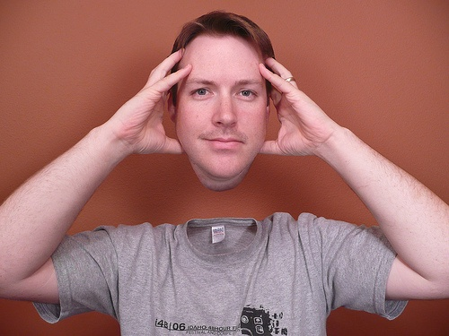
But don’t loose your head now!

Slide 49
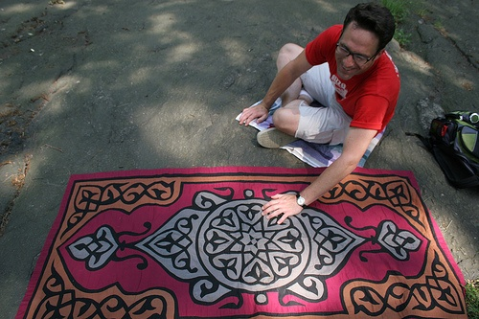
Just because you are on the sweet spot now, doesn’t mean it won’t shift in the future ..

Slide 50
Source
This presentation is Marina Noordegraaf’s visual adaptation of the message and content of the book “The starfish and the spider” by Ori Brafman en Rod A. Beckstrom
(www.starfishandspider.com)

Slide 51
Illustrations
http://xkcd.com/386/
http://www.flickr.com/photos/revcyborg/5228173/
http://www.flickr.com/photos/vernhart/1096594941/in/set-72157600229196934/
http://www.flickr.com/photos/vernhart/1073265478/
http://en.wikipedia.org/wiki/Image:Internet_map_1024.jpg
http://www.flickr.com/photos/herby_fr/241196362/
http://www.flickr.com/photos/inju/1960432516/
http://www.flickr.com/photos/loki/749211708/
http://www.flickr.com/photos/onion83/73048419/
http://www.flickr.com/photos/lonelydxb/2177166095/
http://ourfounder.typepad.com/leblog/WindowsLiveWriter/MarchingtoaDifferentDRMmer_6A0C/image%7B0%7D%5B2%5D.png
http://images.salon.com/opinion/feature/2004/04/07/al_qaidas/story.jpg
http://www.flickr.com/photos/perreira/204942053/
http://www.texasbeyondhistory.net/plateaus/peoples/images/apaches.jpg
http://www.flickr.com/photos/liberato/171610084/
http://www.flickr.com/photos/stephcosta/241926141/
http://www.flickr.com/photos/krazydad/3870810/in/set-104096/
http://www.flickr.com/photos/jan_bakker/272473509/
http://www.flickr.com/photos/42311564@N00/312800567/
http://www.flickr.com/photos/octaviorojas/238466023/
http://www.flickr.com/photos/parl/70999185/
http://www.flickr.com/photos/wurz/338794309/
http://www.flickr.com/photos/thevoicewithin/1388730534/
http://www.flickr.com/photos/adamrice/174742415/
http://www.flickr.com/photos/mllerustad/409480321/
http://www.flickr.com/photos/phitar/46048661/
http://www.flickr.com/photos/_saturnine/1695426689/
http://www.flickr.com/photos/vaguelyartistic/132177047/
http://www.flickr.com/photos/f1rwb/865442362/
http://www.flickr.com/photos/002/364082308/
http://www.flickr.com/photos/cv47al/241474358/
http://www.flickr.com/photos/musigny/501889191/
http://www.flickr.com/photos/anshu_si/215832920/
http://www.flickr.com/photos/fabulous0ne/564435261/
http://www.flickr.com/photos/ableman/457246011/
http://www.flickr.com/photos/fahdad/30720601/
http://www.flickr.com/photos/nathangibbs/98592171/
http://www.flickr.com/photos/rob20/21267451/
http://www.flickr.com/photos/cheesebikini/804099102/

